Slide 1
Complementary Data
CS 4981 ML Production Systems
RJ Nowling

Slide 2
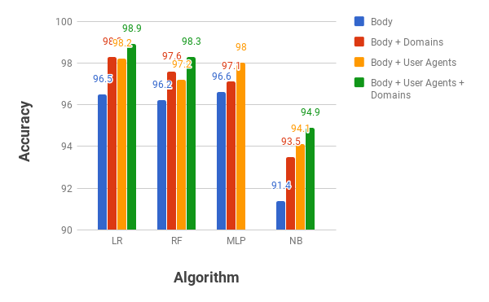

Slide 3
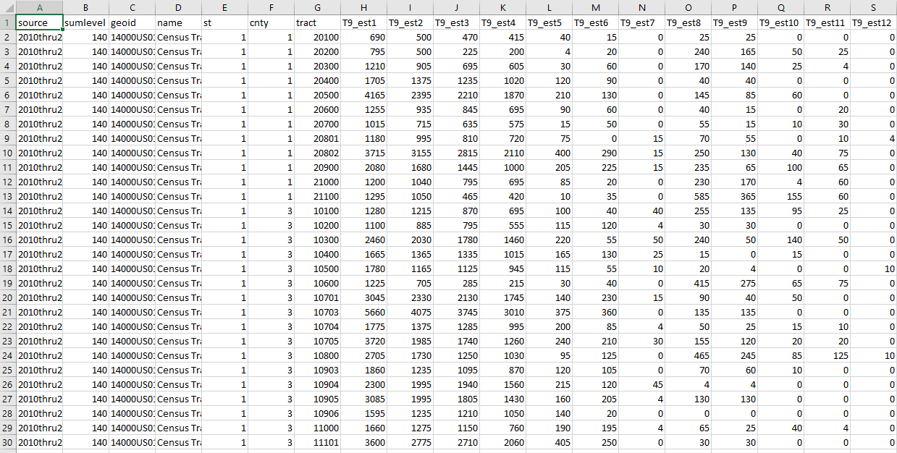
Goal: A Wider Table
https://stackoverflow.com/questions/45848895/how-to-reshape-recast-data-in-excel-from-wide-to-long-format

Slide 4
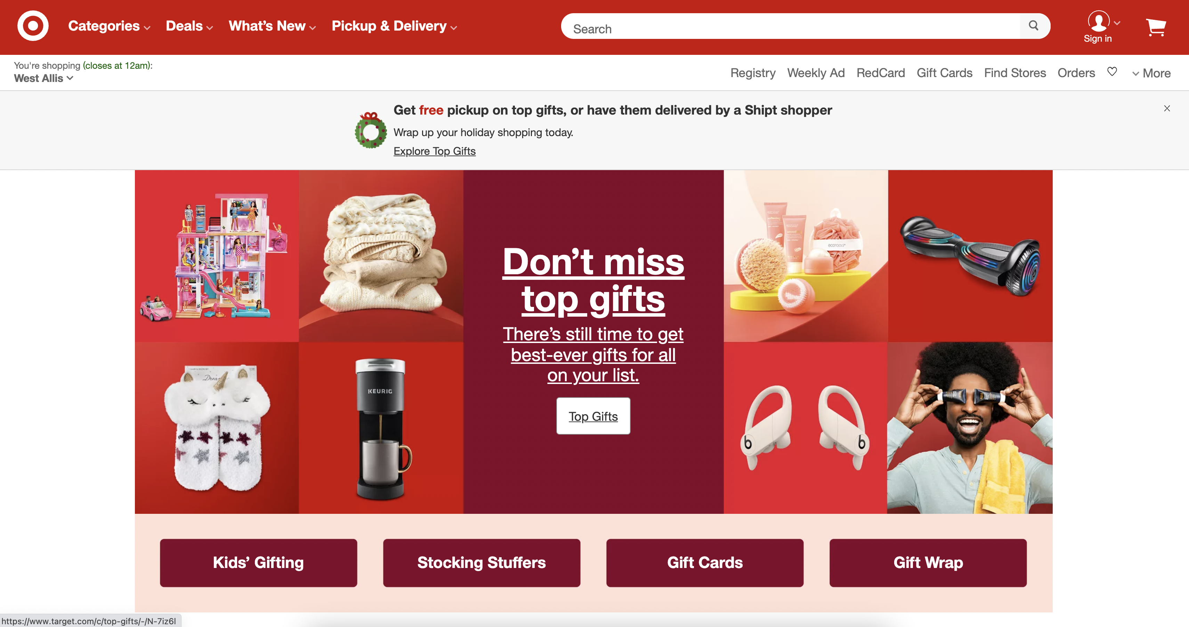
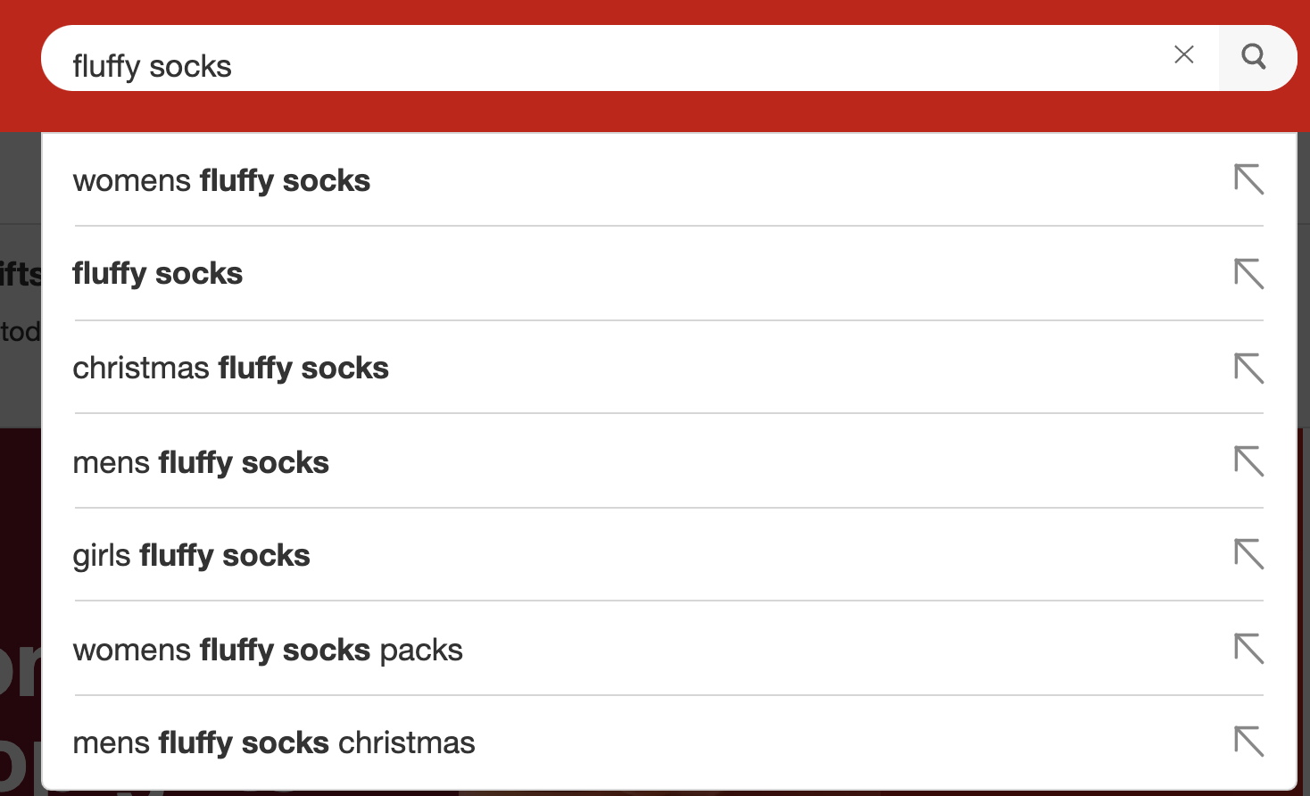
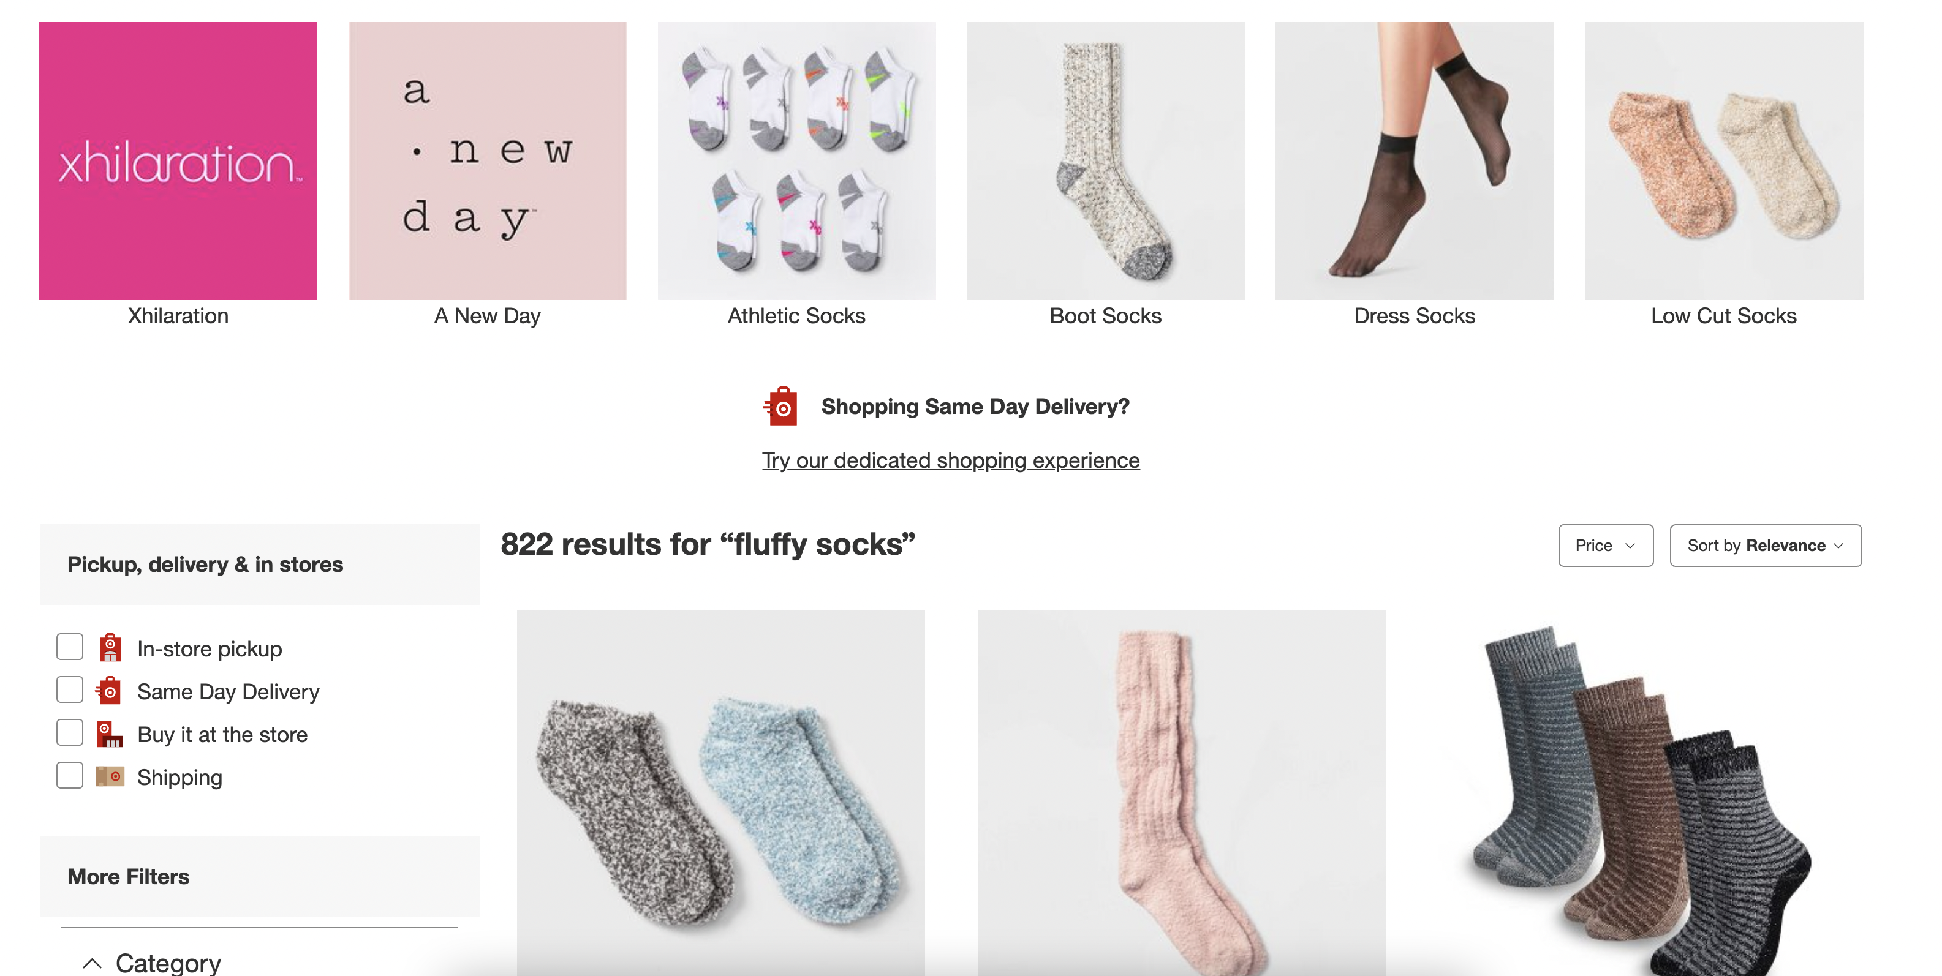
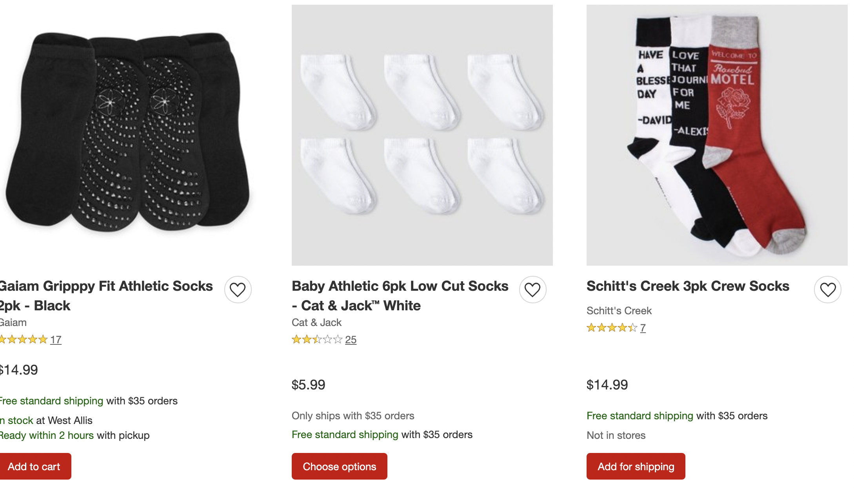
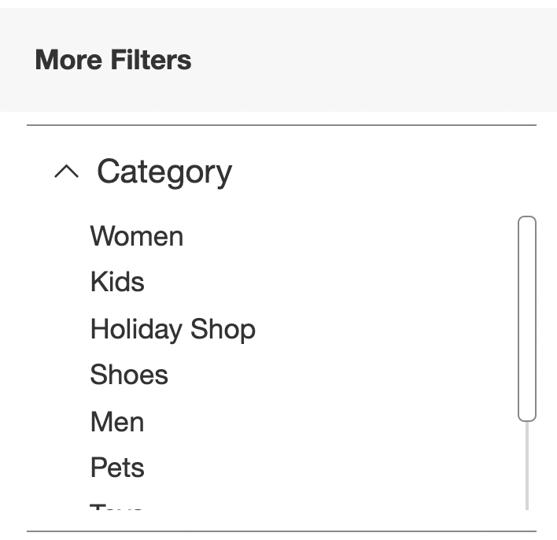
User Visits
Leave, no purchase

Slide 5
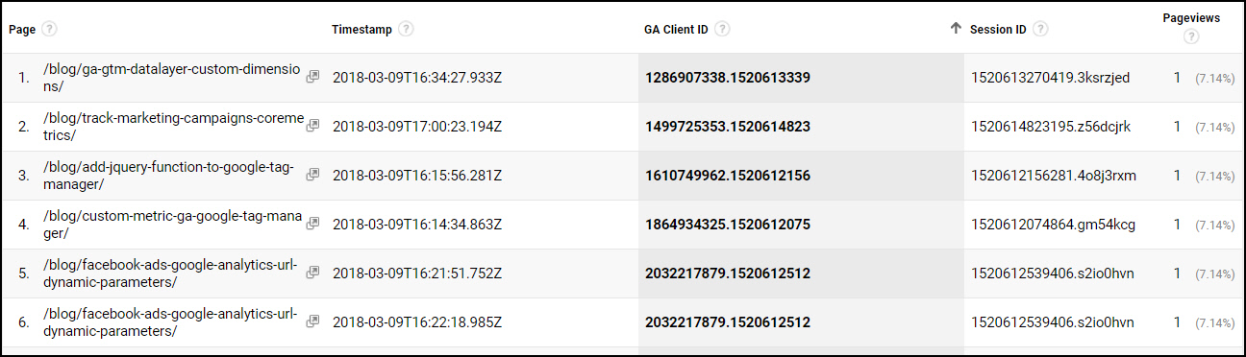
Session-Level Features
https://mixedanalytics.com/blog/quickstart-google-analytics-clickstream-data/

Slide 6
Interpreting URLs
Page type
Home page
Search results
Product page
Employment page
Store location page
Others
Product ids
Search terms
Search filters
Locations
/index
/search?q=fluffy+socks
/search?q=fluffy+socks&gender=men
/product?id=345
/product?id=134
/careers
/stores

Slide 7
Session-Level Features
Number of browsing sessions
Mean length (time and/or number of pages) of browsing sessions
Products and product categories looked at
Number of product viewed
Pages types (search, product, home, employment, shopping cart, checkout, store location, etc.)

Slide 8
Bag of Words Features
Vocabularies
Scaling
Page types
Product IDs
Search terms
Search parameters
Product descriptions
Counts / binary / log counts
Document frequency

Slide 9
Activity Pattern Features
Count of (search -> search results) events
Count of (search results -> product page) events
Count of (product page -> product page) events
Count of (search results -> product page -> search results) events
Count of (search -> product page -> product page) events
Count of (category 1 -> category 2) events

Slide 10
Device Profile
Attribute | Description
Device | Computer, tablet, phone; Infer capability / cost of machine -> buying power / technical sophistication
OS | Infer capability / cost of machine -> buying power / technical sophistication
OS version | Infer capability / cost of machine -> buying power / technical sophistication
Browser | MS browser users more likely to click on ads (less sophisticated users)
Browser version | Older software -> less sophisticated -> more likely to click on ads
Screen resolution | Infer capability / cost of machine -> buying power / technical sophistication
Geographic Location

Slide 11
Product Level
Attribute | Description
Product categories and sub-categories | In general, interested in a job For this web site, interests in this company specifically
Product popularity
Product prices
Consumable | E.g., dog food vs socks
Description
Product sizes

Slide 12
User Profile
"Customer segmentation services"
Oracle Bombora
Segment
Blueconic
They give you some code to add to your web site
Ask you to provide some data on your web site / products
Combine across multiple web sites to infer profile attributes
Share profile attributes with all customers
Users are identified by a unique cookie

Slide 13
User Profile
Attribute | Description
Gender
Age Range | Usually organized as ranges (e.g., < 18, 18-24, 25-30, etc.)
Education | High school, college, graduate degrees
Income | Organized as ranges
Employment | What industry (e.g., customer service, retail, software, education, etc.)? White collar or blue collar?
Interests | E.g., sports, clothing, etc.
Children | Have they browsed or purchased children's items? What age ranges?
Number of online purchases per month
Amount of monthly online purchases

Slide 14
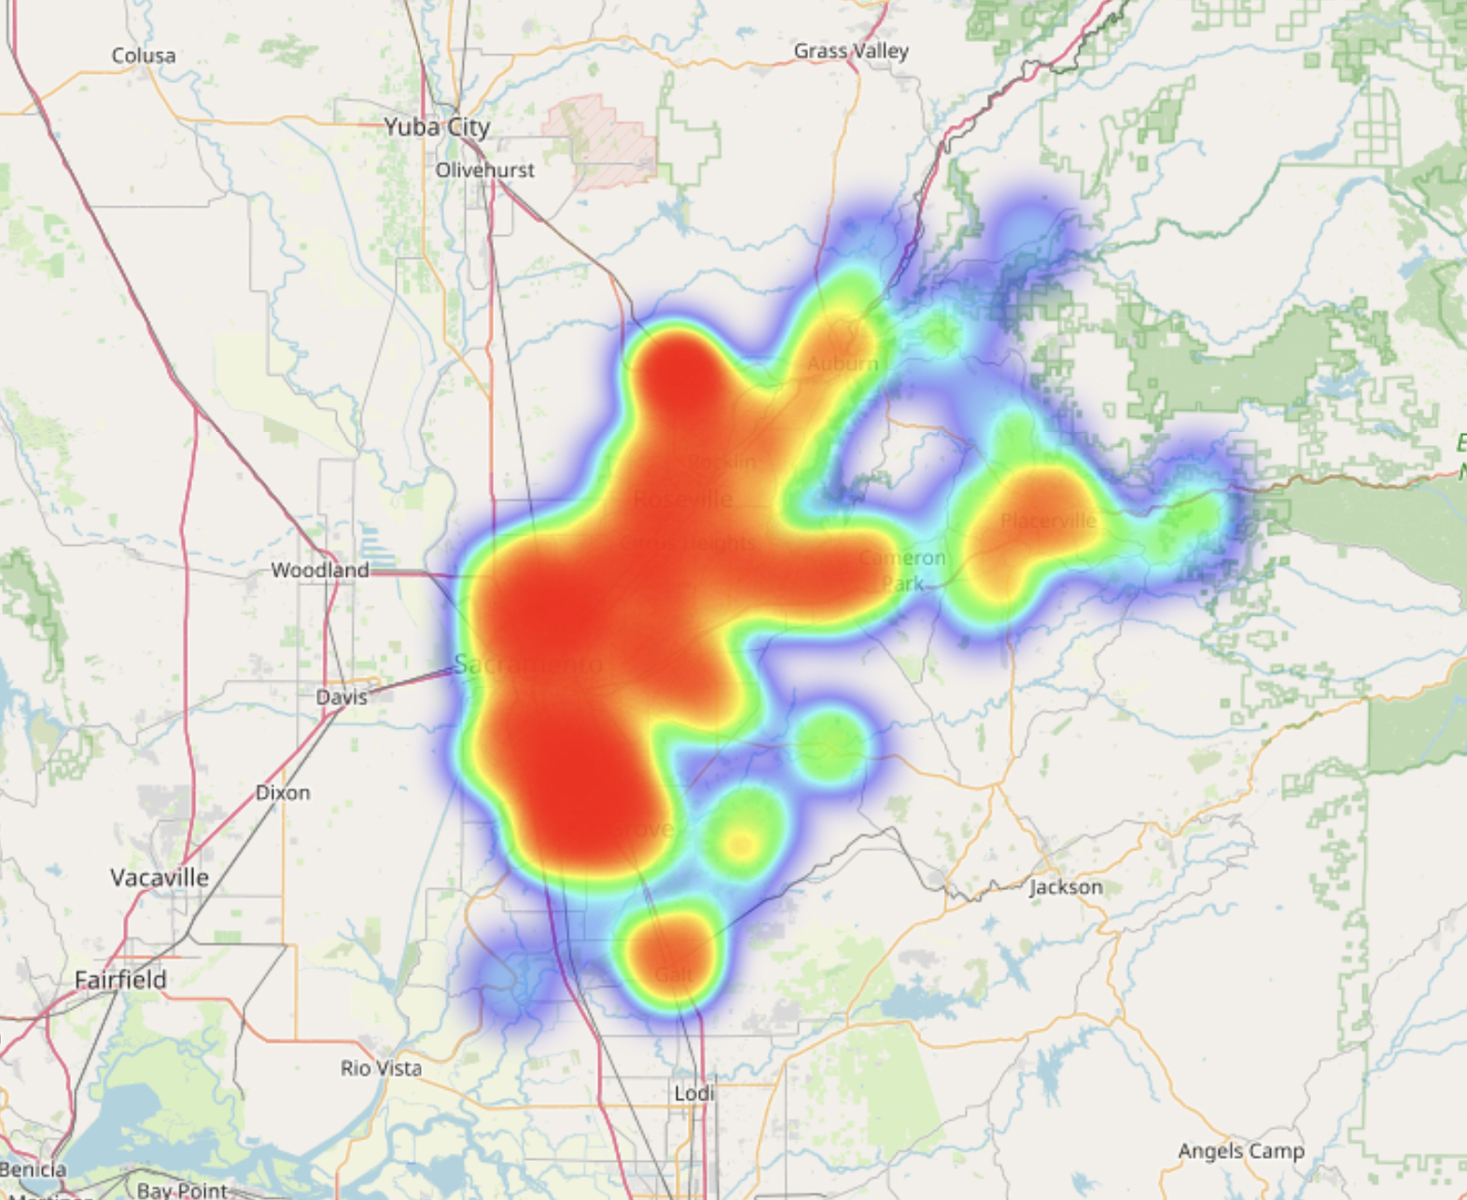
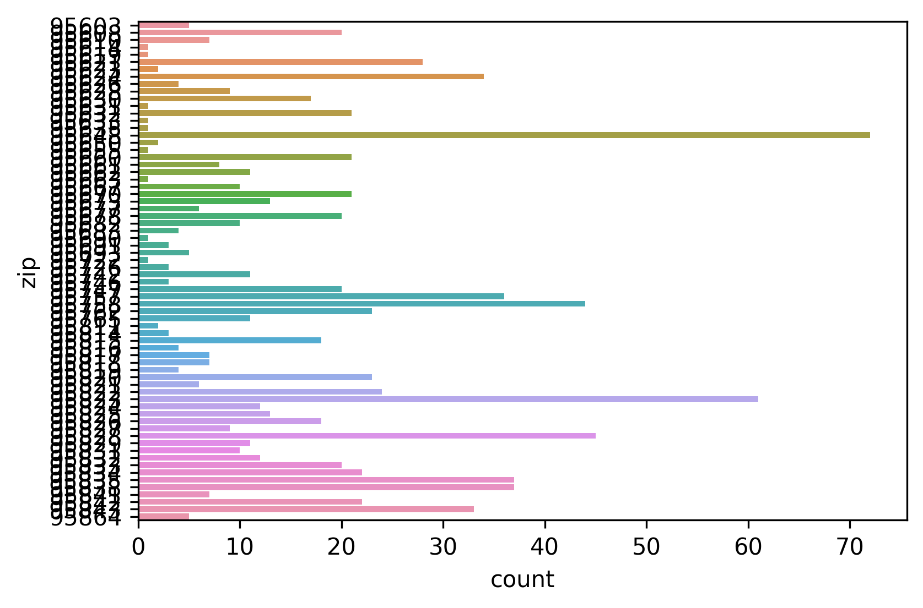
Geographic Locations

Slide 15
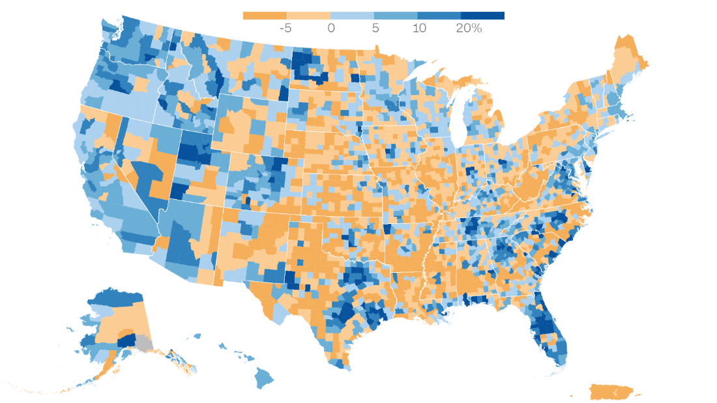
American Community Survey
"The American Community Survey (ACS) is an ongoing survey that provides vital information on a yearly basis about our nation and its people. ...
Through the ACS, we know more about jobs and occupations, educational attainment, veterans, whether people own or rent their homes, and other topics. Public officials, planners, and entrepreneurs use this information to assess the past and plan the future. When you respond to the ACS, you are doing your part to help your community plan for hospitals and schools, support school lunch programs, improve emergency services, build bridges, and inform businesses looking to add jobs and expand to new markets, and more."
U.S. Census Bureau
https://www.cnn.com/2021/08/12/politics/us-census-2020-data/index.html

Slide 16
American Community Survey
Data are broken down by zip code
Statistics include:
Median household income
Population size
Age ranges and sex
Household sizes
Poverty levels
Owning vs renting
Educational attainment
https://www.census.gov/programs-surveys/acs/data.html
https://www.cnn.com/2021/08/12/politics/us-census-2020-data/index.html

Slide 17
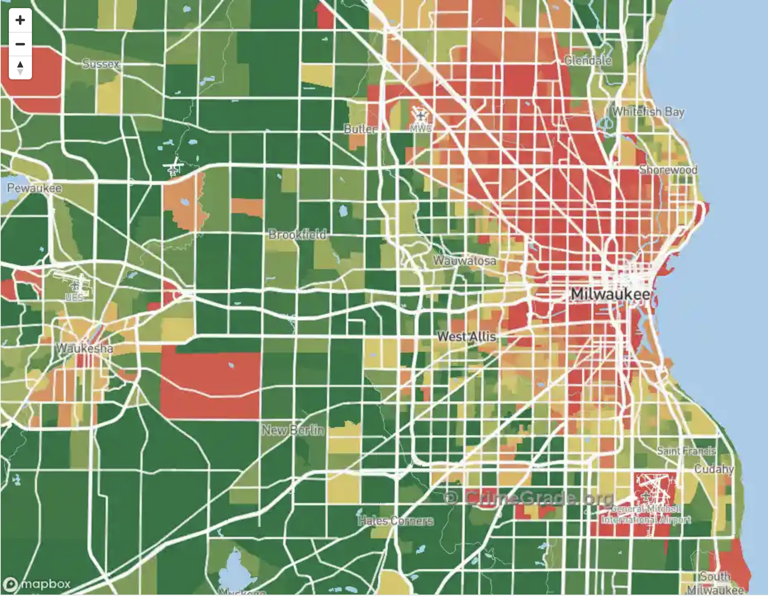
Crime Data
FBI Crime Data Explorer https://crime-data-explorer.app.cloud.gov/pages/home
City Governments. For example, for Milwaukee: https://city.milwaukee.gov/police/Information-Services/Crime-Maps-and-Statistics
https://crimegrade.org/safest-places-in-milwaukee-wi-metro/

Slide 18
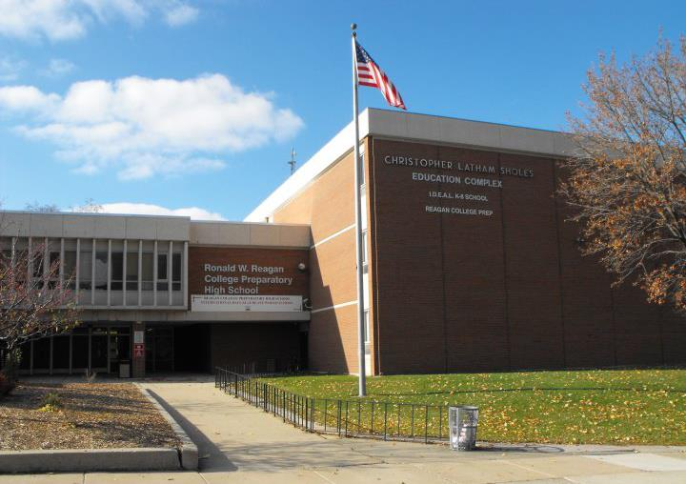
Public School Rating Data
Wisconsin Department of Public Instruction School and District Report Cards https://dpi.wi.gov/accountability/report-cards
Courtesy of RWR College Prep HS

Slide 19
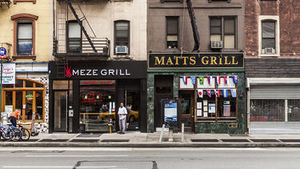
Local Economic Data
Home ownership vs renting rates
Unemployment rates
Cost of living
Number of small vs large businesses
Business types
Ratio of commercial to residential zones
Tax rates (property, sales, income)
https://insights.som.yale.edu/insights/what-do-small-businesses-need

Slide 20

Tax Data
U.S. Census Survey of State and Local Government Finances https://www.census.gov/programs-surveys/gov-finances.html
GETTY images

Slide 21
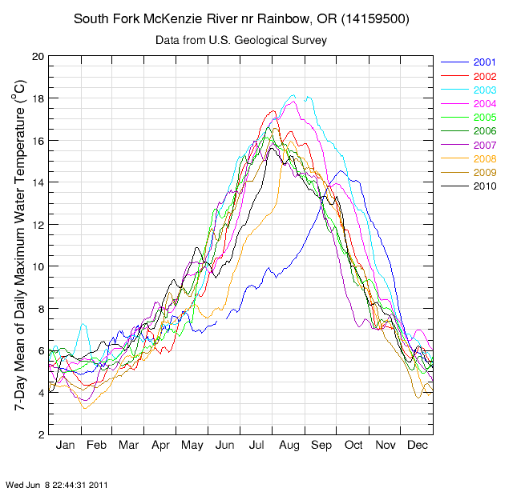
Weather / Climate Data
"Weather refers to short term atmospheric conditions while climate is the weather of a specific region averaged over a long period of time."
USGS
https://tn.water.usgs.gov/grapher/tutorial/examples.html

Slide 22
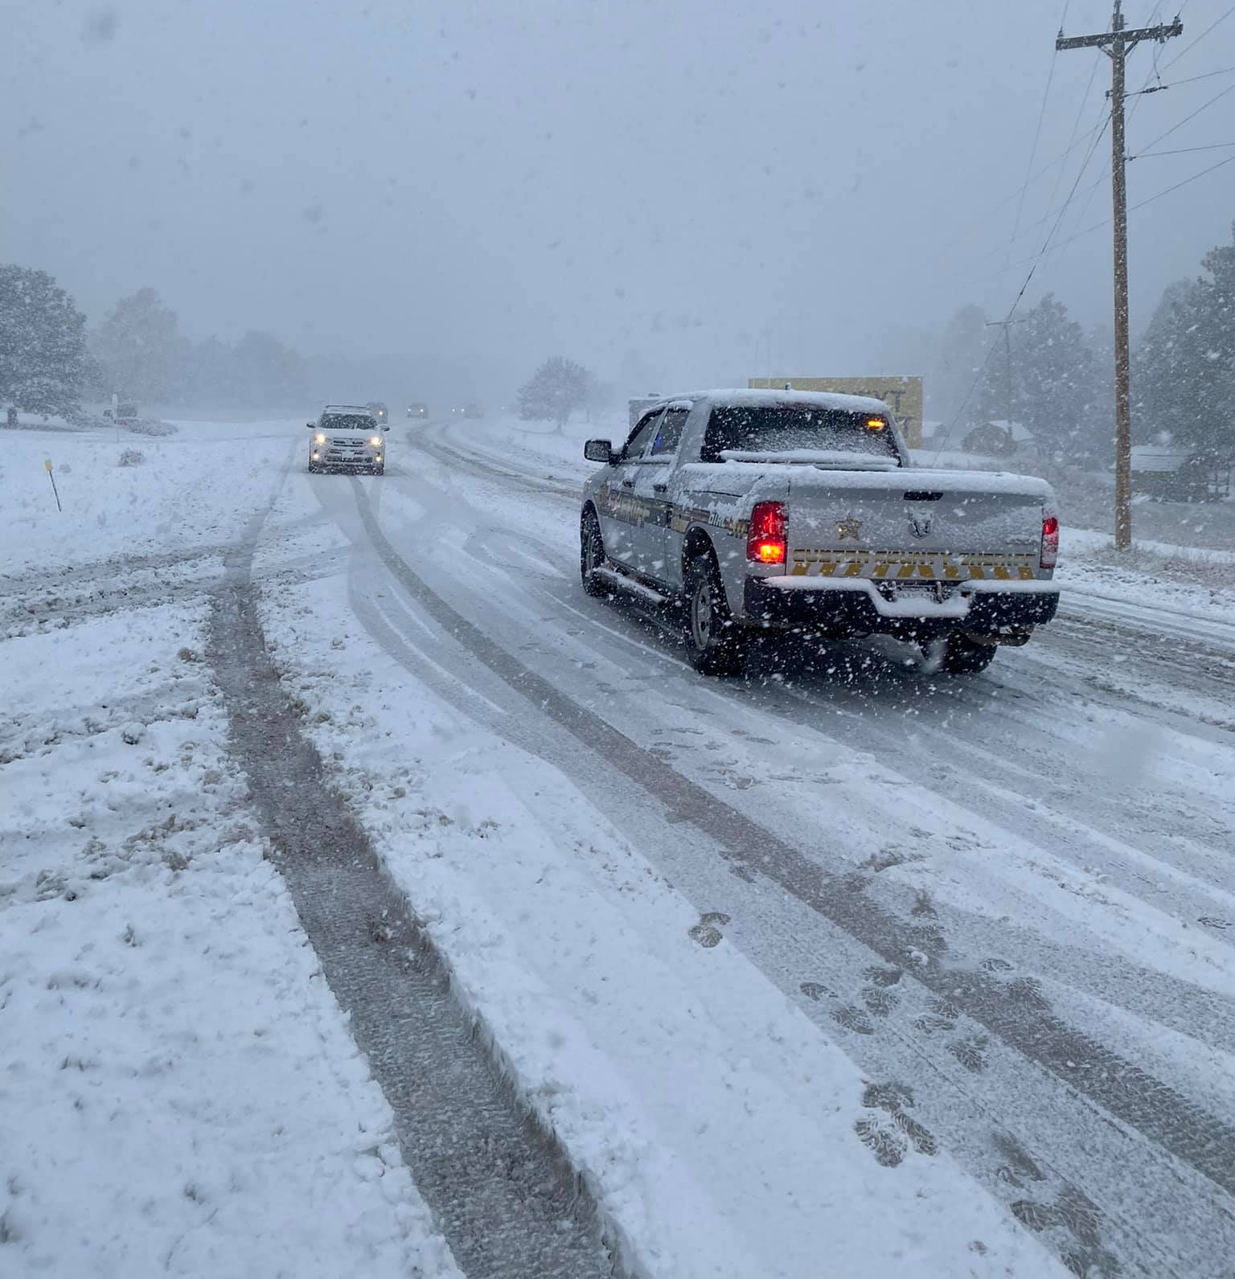
Why do we care?
Behavior changes related to weather conditions:
Buying gloves vs swimsuits
Going out to a restaurant, cooking at home, or ordering food delivery
Use of heating or A/C (energy consumption)
https://www.newscenter1.tv/motorist-advisory-drivers-warned-to-slow-down-on-snowy-roads/

Slide 23

Mobility as a Service
Uber, Lyft, Doordash, etc. are business and technology platforms offer mobility as a service
They facilitate a market which connects drivers to customers
Need to set rates high enough so that drivers are motivated to work
And low enough to attract and maintain customers
https://www.uber.com/us/en/drive/basics/

Slide 24
Surge Pricing
Uber uses "surge pricing" to encourage drivers to be available
When there are not enough drivers to meet demand
prices are increased
drivers earns more
https://www.uber.com/us/en/drive/basics/

Slide 25
Ways to Predict When to Raise Prices
Based on current supply (customers) and demand (drivers). Signals will be highly variable and noisy. Slow response time.
Find patterns (weather, time of day, location, etc.) so that you can adjust prices early enough to avoid shortages
https://www.uber.com/us/en/drive/basics/

Slide 26

Geographic and Satellite Image Data
Elevation
Plant life and types
Soil types
Humidity and rain fall
Type of climate (e.g., Tundra, tropical, humid)
https://unsplash.com/photos/TbwnUGV4kok

Slide 27
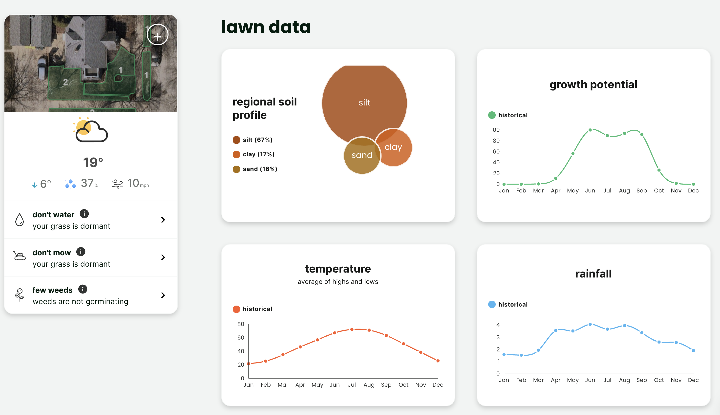
Sunday Lawn Care

Slide 28
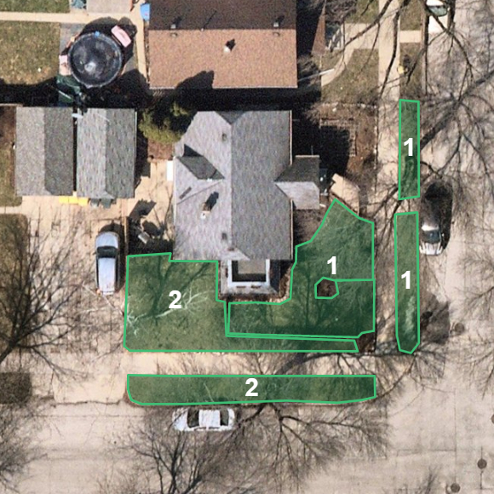
Satellite Photography and Image Segmentation
Use satellite imagery to determine the amount and areas of grass on property
Images are segmented to identify grassy areas
Used to estimate lawn size and how much product you will need

Slide 29
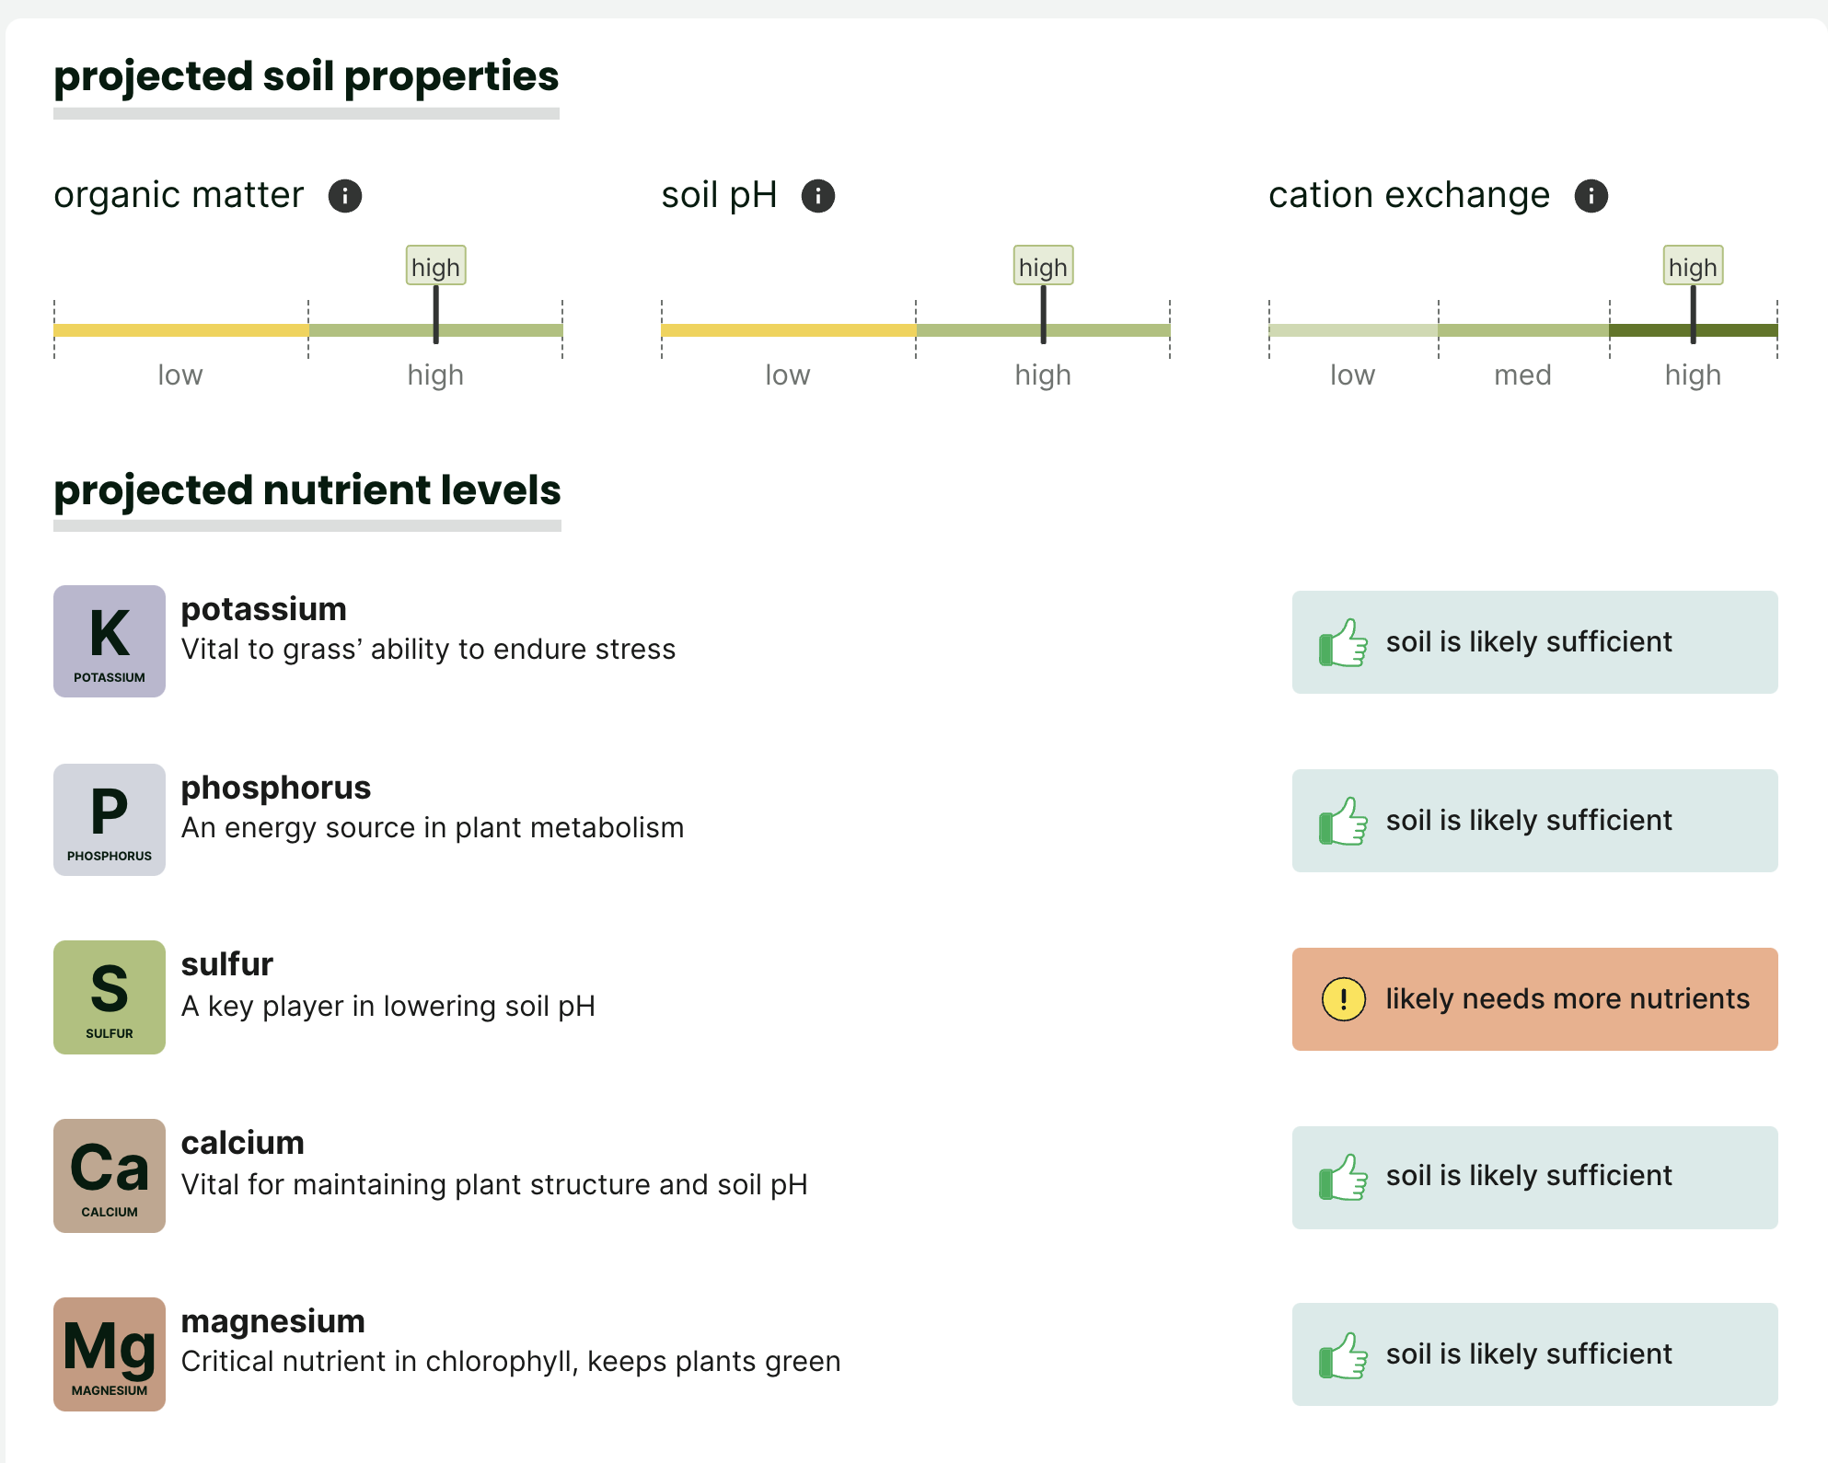
Sunday Lawn Care

Slide 30
Precision Agriculture
Farmers need to make a lot of decisions:
What, where, when to plant
How to fertilize soil
When to harvest
What actions to take based on how crops are doing
If a farm has a bad year, the farmer can lose a lot of money
Analytics can help farmers maximize yield and profits
https://unsplash.com/photos/TbwnUGV4kok

Slide 31
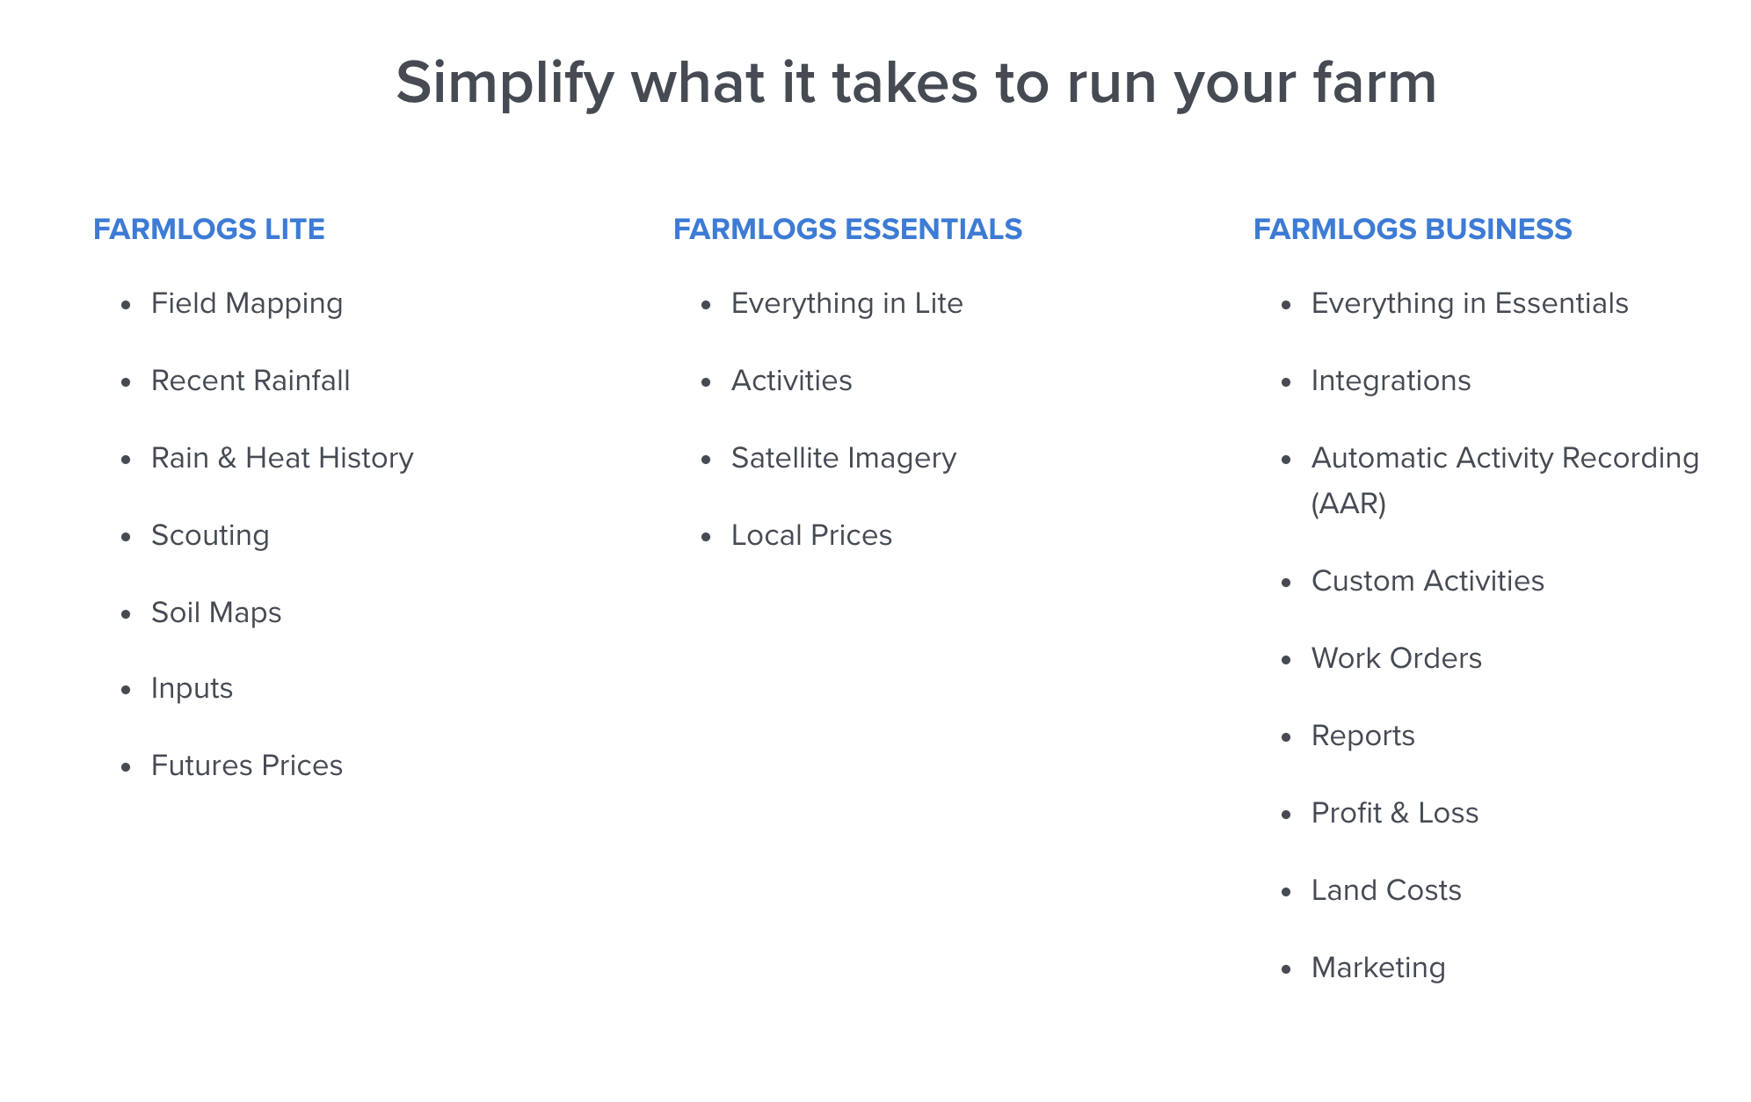
Farm Logs
Farm Logs is one example of such a company
Farm Logs ingests all sorts of weather, climate, geographic data
Sensor data measuring soil, water, and crop properties
Financial and market data

Slide 32
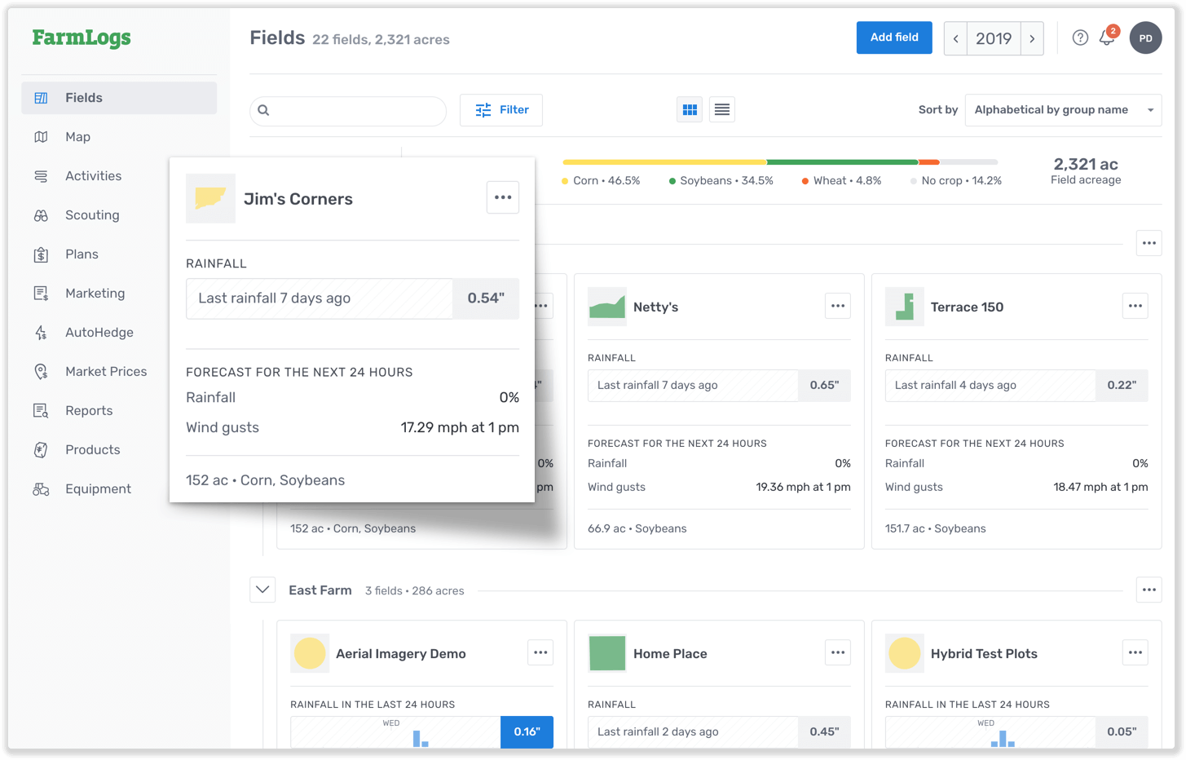
Farm Logs
They use these data to for basic analytics:
Alerting if soil is dry
Warning if weather predictions indicate extreme weather
And advanced analytics:
Predicting crop fields based on plant growth models

Slide 33
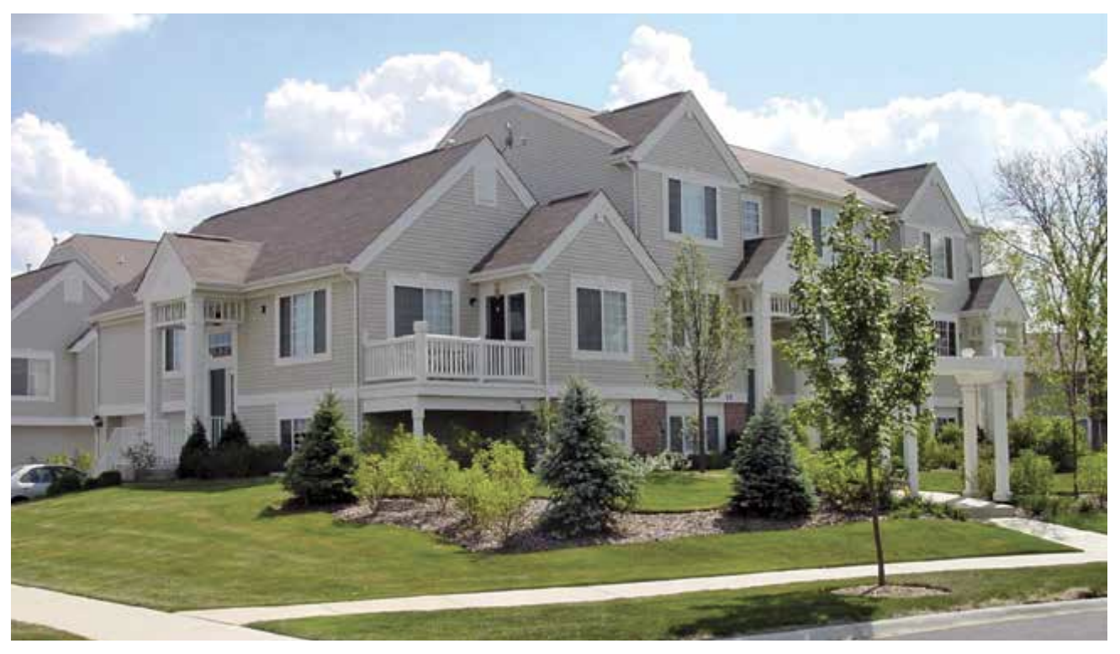
Real Estate Capital Planning
Properties need repairs over time
Think of home repairs: fixing leaks, new appliances, etc.
Large properties such as apartments, office spaces, etc. are no different
But the repairs can be costly
https://www.reserveadvisors.com/wp-content/uploads/2021/09/Reserve-Study-Overview.pdf

Slide 34
Real Estate Capital Planning
Real estate capital planning attempts to predict:
When various repair and maintenance procedures will be needed
To estimate the amount of capital a company will need on hand over time
https://www.reserveadvisors.com/wp-content/uploads/2021/09/Reserve-Study-Overview.pdf

Slide 35
Reserve Advisors
A MSOE alumni runs a company that does exactly this
The company sends engineers out to your site to evaluate it
They have a very long list of items to check and evaluate
Based on that evaluation, they predict time to repair and costs
And then help with financial forecasting
https://www.reserveadvisors.com/wp-content/uploads/2021/09/Reserve-Study-Overview.pdf

Slide 36
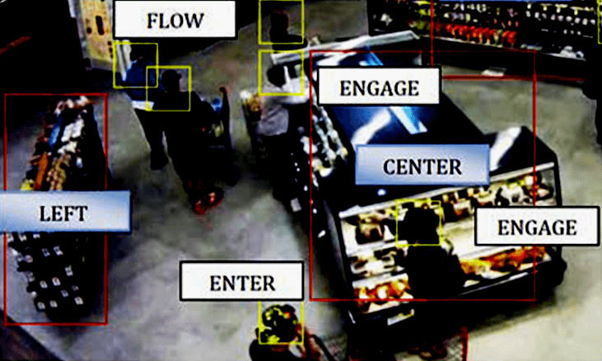
Retail Analytics: In-Store Customer Tracking
Brick and mortar retail companies want to analyze customer intent and behavior just like online businesses
For well over a decade, various technologies have been developed for tracking customer movement in stores
Video analysis, tracking cell signals, etc.
https://behavioranalyticsretail.com/technologies-tracking-people/

Slide 37
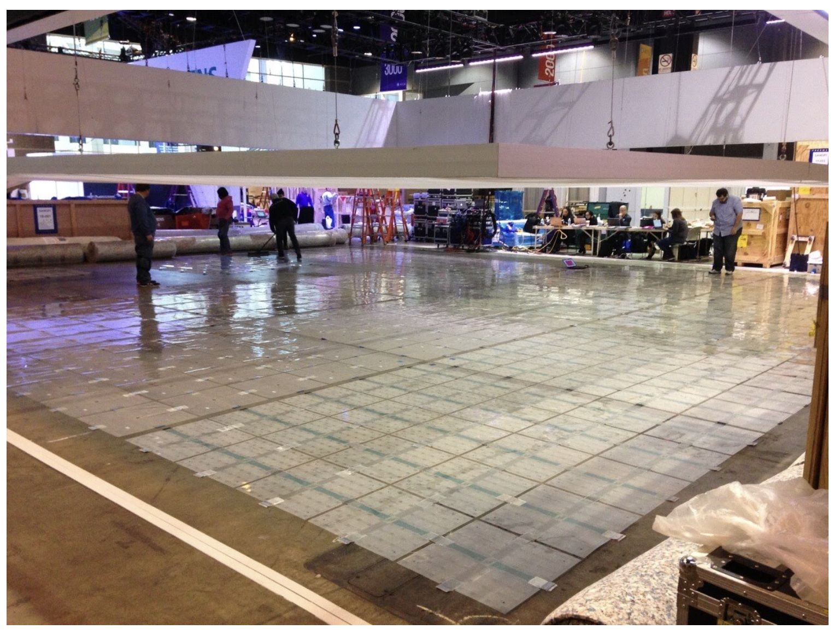
Scanalytics
A local start up created a different approach
They developed proprietary sensors that go under the floor
These sensors measure pressure over time
https://www.scanalyticsinc.com/solesensor

Slide 38
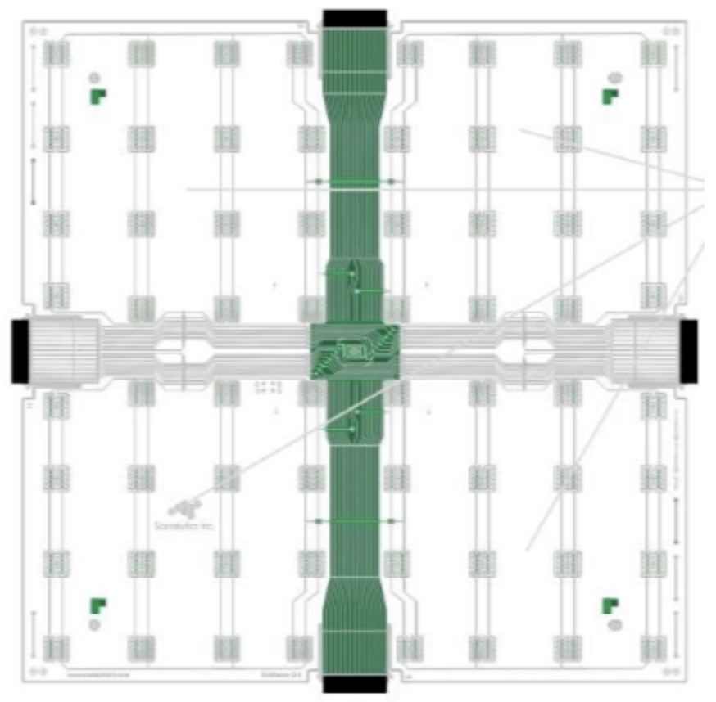
Scanalytics
The sensors measure pressure
The pressure is used to track a customer as they move through a store
These require sophisticated motion tracking algorithms that can handle noise, multiple overlapping paths, etc.
https://www.scanalyticsinc.com/solesensor

Slide 39
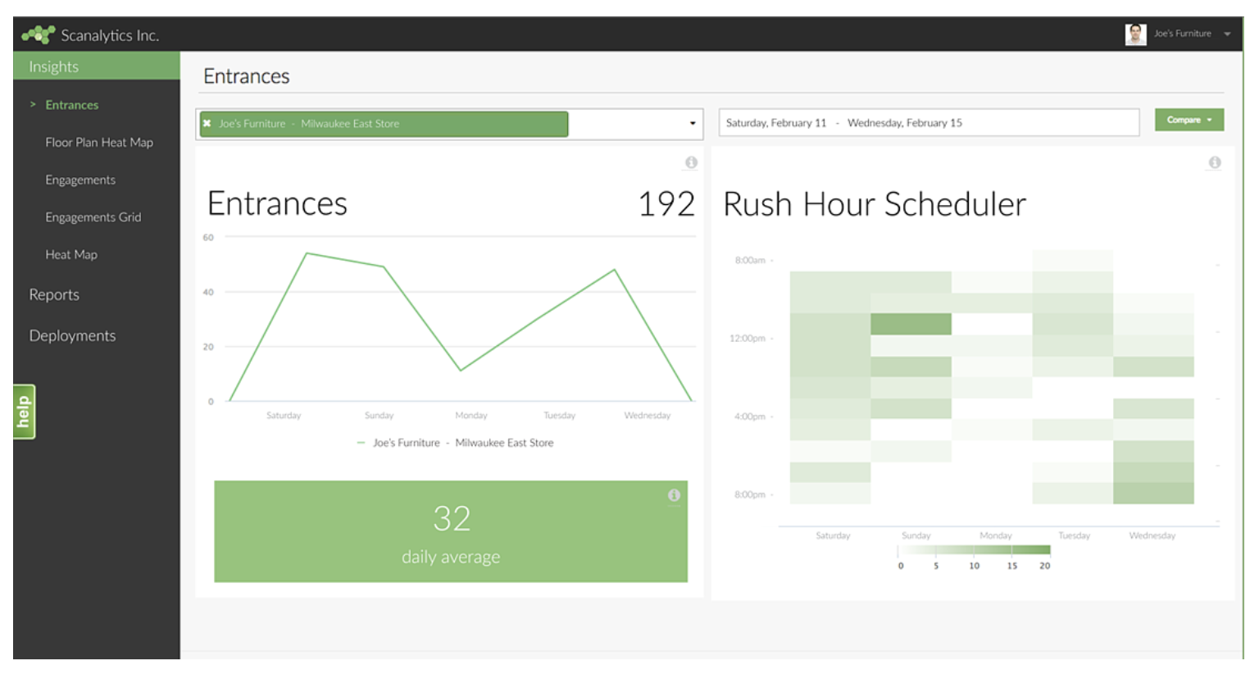
Scanalytics
Analytics software is used to summarize the data and present insights to the business
For examples, sensors placed at entrances can be used to measure the inflow and outflow of customers and thus the total number of customers in the store at any given time
https://www.scanalyticsinc.com/dashboard

Slide 40
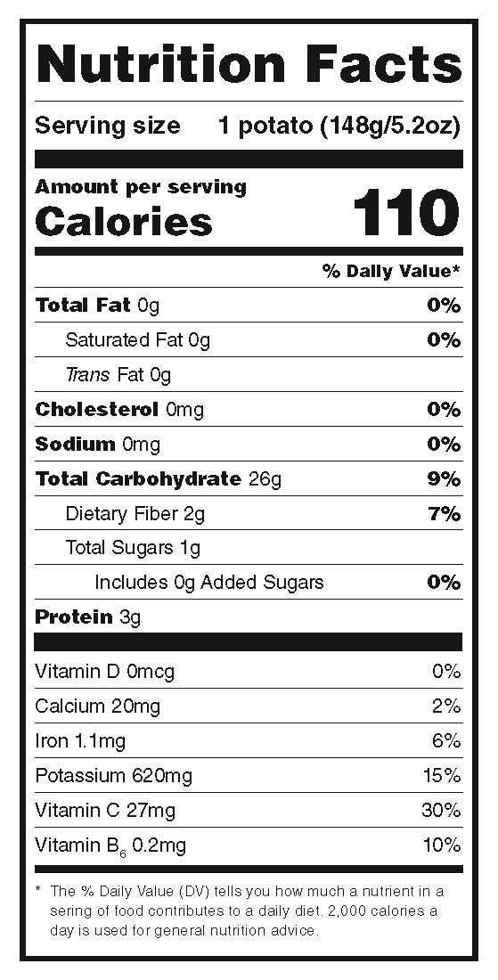
Food
Apps for tracking calories or suggesting recipes need information about the food
Many of these products buy food nutrition databases to populate their app
Use the serving info provided by user to calculate calories and macronutrients
Help user stay under budget
https://www.coloradopotato.org/new-nutrition-label/

